Slide 1
UNIT II
DATA ANALYSIS

Slide 2
Regression
Regression is a statistical technique used to understand the relationship between variables and predict the value of one variable based on another variable.
In simple words:
Regression helps us answer: “If X changes, what is likely to happen to Y?”
Independent variable (X) → the variable used for prediction
Dependent variable (Y) → the variable we want to predict

Slide 3
# Regression Modeling
Regression analysis is a tool for building statistical models that characterize relationships among a dependent variable and one or more independent variables, all of which are numerical.
Simple linear regression involves a single independent variable.
Multiple regression involves two or more independent variables.

Slide 4
->Purpose of Regression Analysis
The purpose of regression analysis is to analyze relationships among variables.
The analysis is carried out through the estimation of a relationship and the results serve the following two purposes:
Answer the question of how much y changes with changes in each of the x's (x1, x2,...,xk),
  Y is the dependent variable
Forecast or predict the value of y based on the values of the X's
  X is the independent variable

Slide 5
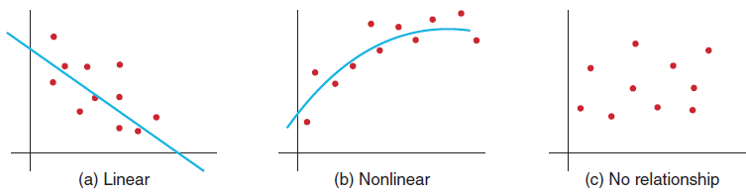
->Simple Linear Regression
Finds a linear relationship between:
- one independent variable X and
- one dependent variable Y
The variable we are trying to predict (Y) is called the dependent (or response) variable.
The variable x is called the independent (or predictor, or explanatory) variable.
First prepare a scatter plot to verify the data has a linear trend.
Use alternative approaches if the data is not linear.

Slide 6
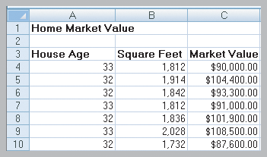
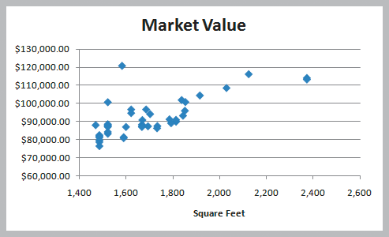
Example
Home Market Value Data
Size of a house is typically related to its market value.
X = square footage
Y = market value ($)
The scatter plot of the full data set (42 homes) indicates a linear trend.

Slide 7
->Multiple Linear Regression
Multiple Regression has more than one independent variable.
Simple vs. Multiple Regression
One dependent variable Y predicted from one independent variable X
One regression coefficient
r²: proportion of variation in dependent variable Y predictable from X
One dependent variable Y predicted from a set of independent variables (X1, X2 ….Xk)
One regression coefficient for each independent variable
R²: proportion of variation in dependent variable Y predictable by set of independent variables (X’s)

Slide 8
#Bayesian method for classification
Bayesian classification is based on Bayes' Theorem. Bayesian classifiers are the statistical classifiers. Bayesian classifiers can predict class membership probabilities such as the probability that a given tuple belongs to a particular class.
Baye's Theorem
Bayes' Theorem is named after Thomas Bayes. There are two types of probabilities −
      Posterior Probability [P(H/X)]
      Prior Probability [P(H)]
where X is data tuple and H is some hypothesis.

Slide 9
Bayes’ Theorem: Basics
Bayes’ Theorem:
  Let X be a data sample (“evidence”): class label is unknown
  Let H be a hypothesis that X belongs to class C
  Classification is to determine P(H|X), (i.e., posteriori probability): the probability that the hypothesis holds given the observed data sample X
  P(H) (prior probability): the initial probability
    E.g., X will buy computer, regardless of age, income, …
  P(X): probability that sample data is observed
  P(X|H) (likelihood): the probability of observing the sample X, given that the hypothesis holds
    E.g., Given that X will buy computer, the prob. that X is 31..40, medium income

Slide 10
Prediction Based on Bayes’ Theorem
Given training data X, posteriori probability of a hypothesis H, P(H|X), follows the Bayes’ theorem
Informally, this can be viewed as
  posteriori = likelihood x prior/evidence
Predicts X belongs to C_{i} iff the probability P(C_{i}|X) is the highest among all the P(C_{k}|X) for all the k classes
Practical difficulty: It requires initial knowledge of many probabilities, involving significant computational cost

Slide 11
Classification Is to Derive the Maximum Posteriori
Let D be a training set of tuples and their associated class labels, and each tuple is represented by an n-D attribute vector X = (x₁, x₂, …, x_{n})
Suppose there are m classes C₁, C₂, …, C_{m}.
Classification is to derive the maximum posteriori, i.e., the maximal P(C_{i}|X)
This can be derived from Bayes’ theorem
Since P(X) is constant for all classes, only
  needs to be maximized

Slide 12
Naïve Bayes Classifier: Training Dataset
Class:
C1:buys_computer = ‘yes’
C2:buys_computer = ‘no’
Data to be classified:
X = (age <=30,
Income = medium,
Student = yes
Credit_rating = Fair)

Slide 13
Naïve Bayes Classifier: An Example
P(C_{i}): P(buys_computer = “yes”) = 9/14 = 0.643
P(buys_computer = “no”) = 5/14= 0.357
Compute P(X|C_{i}) for each class
  P(age = “<=30” | buys_computer = “yes”) = 2/9 = 0.222
  P(age = “<= 30” | buys_computer = “no”) = 3/5 = 0.6
  P(income = “medium” | buys_computer = “yes”) = 4/9 = 0.444
  P(income = “medium” | buys_computer = “no”) = 2/5 = 0.4
  P(student = “yes” | buys_computer = “yes) = 6/9 = 0.667
  P(student = “yes” | buys_computer = “no”) = 1/5 = 0.2
  P(credit_rating = “fair” | buys_computer = “yes”) = 6/9 = 0.667
  P(credit_rating = “fair” | buys_computer = “no”) = 2/5 = 0.4
X = (age <= 30 , income = medium, student = yes, credit_rating = fair)
P(X|C_{i}) : P(X|buys_computer = “yes”) = 0.222 x 0.444 x 0.667 x 0.667 = 0.044
P(X|buys_computer = “no”) = 0.6 x 0.4 x 0.2 x 0.4 = 0.019
P(X|C_{i})*P(C_{i}) : P(X|buys_computer = “yes”) * P(buys_computer = “yes”) = 0.028
P(X|buys_computer = “no”) * P(buys_computer = “no”) = 0.007
Therefore, X belongs to class (“buys_computer = yes”)

Slide 14
Naïve Bayes Classifier: Comments
Advantages
  Easy to implement
  Good results obtained in most of the cases
Disadvantages
  Assumption: class conditional independence, therefore loss of accuracy
  Practically, dependencies exist among variables
    E.g., hospitals: patients: Profile: age, family history, etc.
      Symptoms: fever, cough etc., Disease: lung cancer, diabetes, etc.
    Dependencies among these cannot be modeled by Naïve Bayes Classifier.

Slide 15
Using IF-THEN Rules for Classification
Represent the knowledge in the form of IF-THEN rules
  R: IF age = youth AND student = yes THEN buys_computer = yes
  The IF part of the rule is called rule antecedent or precondition.
  The THEN part of the rule is called rule consequent.
Assessment of a rule: coverage and accuracy
  n_{covers} = # of tuples covered by R
  n_{correct} = # of tuples correctly classified by R
  coverage(R) = n_{covers} /|D| /* D: training data set */
  accuracy(R) = n_{correct} / n_{covers}

Slide 16
Decision Tree Induction: An Example
Training data set: Buys_computer
The data set follows an example of Quinlan’s ID3 (Playing Tennis)
Resulting tree:
age?
<=30
overcast
>40
31..40
student?
yes
credit rating?
no
yes
excellent
fair
no
yes
no
yes

Slide 17
Algorithm for Decision Tree Induction
Basic algorithm (a greedy algorithm)
  Tree is constructed in a top-down recursive divide-and-conquer manner
  At start, all the training examples are at the root
  Attributes are categorical (if continuous-valued, they are discretized in advance)
  Examples are partitioned recursively based on selected attributes
  Test attributes are selected on the basis of a heuristic or statistical measure (e.g., information gain)
Conditions for stopping partitioning
  All samples for a given node belong to the same class
  There are no remaining attributes for further partitioning – majority voting is employed for classifying the leaf
  There are no samples left

Slide 18
#Analysis of Time Series
Time series is a sequence of observations of categorical or numeric variables indexed by a date, or timestamp.
A simple example is the price of a stock in the stock market at different points of time on a given day.
Another example is the amount of rainfall in a region at different months of the year.

Slide 19
The basic syntax for ts() function in time series analysis is −
timeseries.object.name <- ts(data, start, end, frequency) Following is the description of the parameters used −
data is a vector or matrix containing the values used in the time series.
start specifies the start time for the first observation in time series.
end specifies the end time for the last observation in time series.
frequency specifies the number of observations per unit time.

Slide 20

Example
# Get the data points in form of a R vector.
rainfall<- c(799,1174.8,865.1,1334.6,635.4,918.5,685.5,998.6,784.2,985,882.8,1071)
# Convert it to a time series object.
rainfall.timeseries <- ts(rainfall,start = c(2012,1),frequency = 12)
# Print the timeseries data.
print(rainfall.timeseries)
Output:

Slide 21
->Different Time Intervals
The value of the frequency parameter in the ts() function decides the time intervals at which the data points are measured. A value of 12 indicates that the time series is for 12 months. Other values and its meaning is as below −
frequency = 12 pegs the data points for every month of a year.
frequency = 4 pegs the data points for every quarter of a year.
frequency = 6 pegs the data points for every 10 minutes of an hour.
frequency = 24*6 pegs the data points for every 10 minutes of a day.

Slide 22
#Linear Systems Analysis
Refers to a set of mathematical techniques that can be used to analyze and describe input/output systems that satisfy certain linearity assumptions.
The inputs and outputs of linear systems are represented as functions.
These functions can be any number of variables such as time(t) or space(x) or two variables , space-to-space(x.y) or space-time(x,t).
Linear system analysis is concerned with the study of equilibrium and change in dynamical systems, that is, in systems that contain variables that may change with time.
These variables include system inputs (external causes of change or excitation), outputs (measurable results or effects of the behavior, response, or dynamics of the system), as well as variables describing internal states of the system.

Slide 23
For example, the input function might represent the variation in light level on a single receptor over time, the spatial distribution of light entering the eye , or the spatial distribution of neural activity transmitted from eye to the brain along the optic nerve.
The output function might represent the electrical response of the receptor over time, the spatial distribution of light falling on the retina , or the spatial distribution of neural activity of a group of cells receiving inputs from the optic nerve.

Slide 24
#Correlations
A correlation describes a relationship between two variables.
There are different types of correlations that correspond to different levels of measurement.
Its characteristics:
The direction of relationship
1. Positive correlation (Two variables tend to move in the same direction) (+)
2. Negative correlation (Two variables tend to move in the opposite direction) (-)

Slide 25
b. The form of the relationship
The relationship tend to have a linear form. (parabolic, in other words; not a straight-line relationship)
The degree of the relationship
A correlation measures how well the data fit the specific form being considered.
A perfect correlation : +1
No fit: 0

Slide 26
Where and why correlations are used:
1. Prediction: If two variables are known to be related in some systematic way, it possible to use one of the variables to make accurate predictions about the other.
2. Validity: Suppose that you develop a new test for a specific purpose. How could you show that this test truly is measuring what it claims?
3. Reliability: A measurement procedure is considered reliable to the extent that it produces stable consistent measurement.
4. Theory Verification: Many theories make some specific prediction about the relationship between two variables

Slide 27
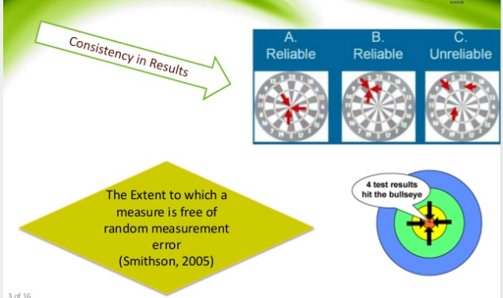
→Reliability

Slide 28
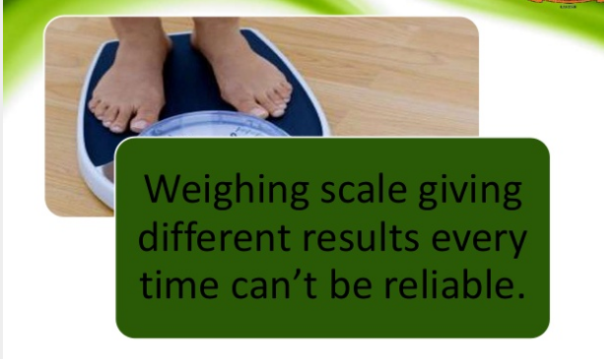
Example

Slide 29
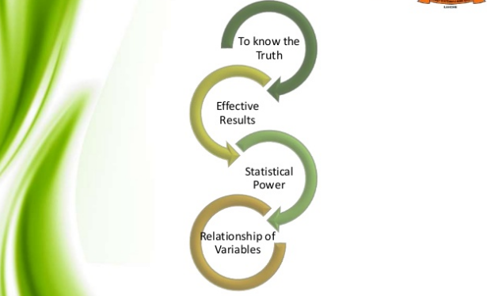
Significance/ Necessity for Reliability

Slide 30
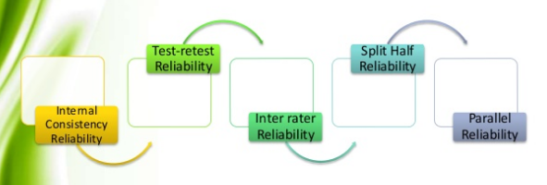
Types of Reliability

Slide 31
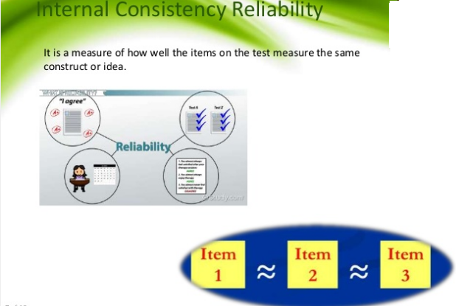

Slide 32
Internal consistency reliability is a measure of how well the different questions/items in a questionnaire or test measure the same underlying concept.
If several questions are supposed to measure the same thing, the answers to those questions should be reasonably consistent with each other.

Slide 33
Imagine a customer satisfaction survey for a restaurant:
The food quality is good.
I am satisfied with the taste of the food.
The food meets my expectations.
I am happy with the food quality.
I would recommend the restaurant because of its food.
These items are all related to food satisfaction.
If students/customers respond to them in a consistent pattern, the scale will have high internal consistency.

Slide 34
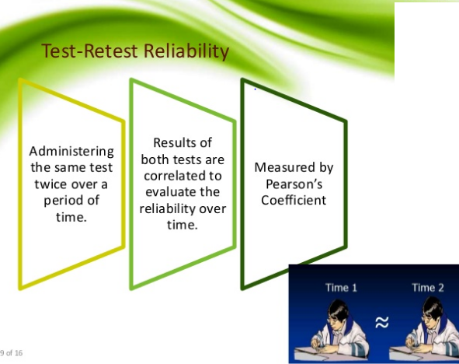

Slide 35
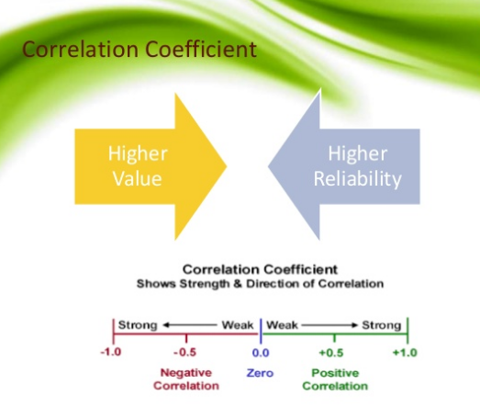

Slide 36
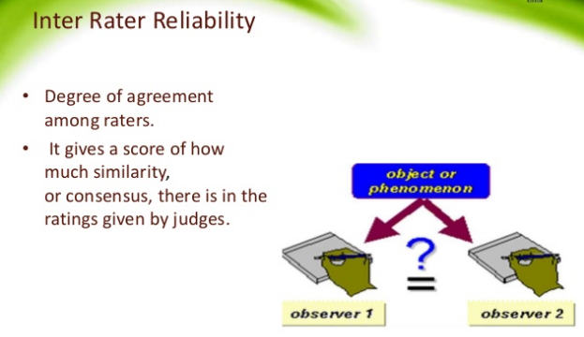

Slide 37
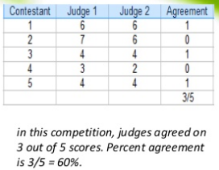


Measurement of Inter rater reliability

Slide 38

Split-half reliability
Split-half reliability checks whether two parts of the same test measure the same concept consistently.
In split-half reliability, a test for a single knowledge area is split into two parts and then both parts given to one group of students at the same time.
The scores from both parts of the test are correlated.
A reliable test will have high correlation, indicating that a student would perform equally well (or as poorly) on both halves of the test.
Split-half = Split the test → Compare the
two halves → Check consistency

Slide 39
Parallel Forms Reliability
Split half-reliability is similar to parallel forms reliability, which uses one set of questions divided into two equivalent sets.
The sets are given to the same students, usually within a short time frame, like one set of test questions on Monday and another set on Friday.
With split-half reliability, the two tests are given to one group of students who sit the test at the same time.
Another difference: the two tests in parallel forms reliability are equivalent and are independent of each other.
This is not true with split-half reliability; the two sets do not have to be equivalent (“parallel”).

Slide 40
#Analysis of variance (ANOVA)
Analysis of Variance (ANOVA) is a parametric statistical technique used to compare datasets. Or ANOVA is a statistical technique used to determine whether there is a significant difference between the means of three or more groups.
This technique was invented by R.A. Fisher, and is thus often referred to as Fisher’s ANOVA, as well.
Analysis of variance (ANOVA) is best applied where more than 2 populations or samples are meant to be compared.

Slide 41
For example, suppose a teacher wants to know whether three different teaching methods produce different student marks.
Teaching Method | Marks
Method A | 65, 70, 68, 72, 67
Method B | 75, 78, 80, 76, 79
Method C | 60, 62, 65, 61, 63
We can calculate the average:
Method A → approximately 68.4
Method B → approximately 77.6
Method C → approximately 62.2
The question is:
Are these differences in average marks statistically significant?
This is where ANOVA is used.

Slide 42
Types:
1. One-Way ANOVA
One-Way ANOVA is used when we have:
  One independent variable (factor)
  Three or more groups/categories
  One dependent variable
Real-Time Example: Teaching Methods
A college wants to find out whether different teaching methods affect students' examination marks.
There are 3 teaching methods:
  Method A – Traditional teaching
  Method B – Video-based teaching
  Method C – Interactive teaching

Slide 43
Student marks:
Traditional | Video-Based | Interactive
60 | 72 | 82
65 | 75 | 85
62 | 70 | 80
58 | 78 | 88
64 | 74 | 84
Does the teaching method significantly affect students' marks?
Variables
Independent variable: Teaching Method
Groups: Traditional, Video, Interactive
Dependent variable: Student marks
When to use?
Use One-Way ANOVA when there is only ONE factor.
Easy memory:
ONE factor → ONE-Way ANOVA

Slide 44
2. Two-Way ANOVA
Two-Way ANOVA is used when we have two independent variables (factors).
It allows us to study:
  Effect of Factor 1
  Effect of Factor 2
  Interaction between Factor 1 and Factor 2
Real-Time Example: Teaching Method + Learning Mode
Suppose a university wants to study whether student marks depend on:
Factor 1 → Teaching Method
Traditional
Video
Interactive

Slide 45
Factor 2 → Learning Mode
  Online
  Offline
  Student marks could be organized like this:
Teaching Method | Online | Offline
Traditional | 65 | 70
Video | 75 | 78
Interactive | 82 | 88
Question 1: Effect of Teaching Method
Does teaching method affect student marks?
This examines:
Traditional vs Video vs Interactive

Slide 46
Question 2: Effect of Learning Mode
Does online/offline learning affect student marks?
This examines:
Online vs Offline

Slide 47
ANOVA in Real Life
ANOVA is used in many fields.
Education
Compare student performance under different teaching methods.
Business
Compare sales under different advertising strategies.
Marketing
Compare customer responses to different advertisements.
Medicine
Compare effectiveness of different treatments.
Agriculture
Compare crop yield using different fertilizers.
Manufacturing
Compare production output using different machines.
Psychology
Compare stress levels under different experimental conditions.
Data Science
Compare model performance across different experimental conditions.

Slide 48
# Classification Trees
A Decision Tree is an algorithm used for supervised learning problems such as classification or regression.
A decision tree or a classification tree is a tree in which each internal (nonleaf) node is labeled with an input feature.
The arcs coming from a node labeled with a feature are labeled with each of the possible values of the feature.
Each leaf of the tree is labeled with a class or a probability distribution over the classes.
A tree can be "learned" by splitting the source set into subsets based on an attribute value test.
This process is repeated on each derived subset in a recursive manner called recursive partitioning.

Slide 49
Decision trees used in data mining are of two main types −
Classification tree − when the response is a nominal variable, for example if an email is spam or not.
Regression tree − when the predicted outcome can be considered a real number (e.g. the salary of a worker).
Classification tree methods (i.e., decision tree methods) are recommended when the data mining task contains classifications or predictions of outcomes, and the goal is to generate rules that can be easily explained and translated into SQL or a natural query language.
A Classification tree labels, records, and assigns variables to discrete classes. A Classification tree can also provide a measure of confidence that the classification is correct.

Slide 50
A Classification tree is built through a process known as binary recursive partitioning. This is an iterative process of splitting the data into partitions, and then splitting it up further on each of the branches.
Initially, a Training Set is created where the classification label (i.e., purchaser or non-purchaser) is known (pre-classified) for each record.
Next, the algorithm systematically assigns each record to one of two subsets on the some basis (i.e., income > $75,000 or income <= $75,000).

Slide 51
The object is to attain an homogeneous set of labels (i.e., purchaser or non-purchaser) in each partition.
This partitioning (splitting) is then applied to each of the new partitions.
The process continues until no more useful splits can be found.
The heart of the algorithm is the rule that determines the initial split rule.

Slide 52
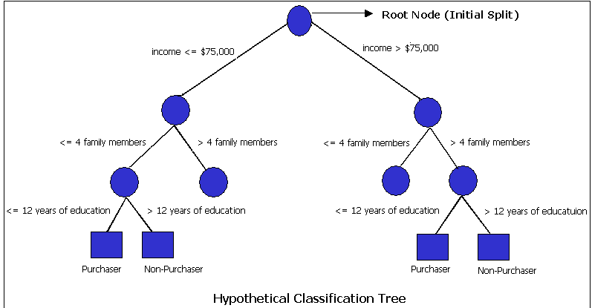

Slide 53
#Association in Decision Trees
Association is not a separate type of Decision Tree.
In data mining, association usually refers to discovering relationships between variables/items, while a decision tree is mainly used for classification or prediction.
However, association can be explained alongside decision trees because both are used to discover useful patterns from data.

Slide 54
Example
Supermarket
Suppose a supermarket analyzes thousands of customer transactions.
It discovers:
Customers who buy bread often also buy butter.
This is an association.
Another example:
Customers who buy a laptop often buy a laptop bag.
So association answers:
"What things are commonly related or occur together?"

Slide 55
Association vs Decision Tree
Association | Decision Tree
Finds relationships/patterns | Makes predictions/decisions
Looks for items occurring together | Uses conditions to split data
Usually produces rules | Produces a tree
Example: Bread → Butter | Example: Income + Age → Buy Laptop?
Common technique: Apriori | Common technique: ID3, C4.5, CART

Slide 56
How Association Can Be Seen in a Decision Tree
Consider an e-commerce company.
It wants to predict whether a customer will buy a smartphone.
The available information is:
  Age
  Income
  Previous purchases
  Website visits
A decision tree might look like:

Slide 57
Income?
/ \
< ₹50,000 ≥ ₹50,000
/ \
Age? Previous Purchase?
/ \ / \
< 30 ≥ 30 Yes No
/ \ | |
Buy Don't Buy Don't
The tree discovers patterns such as:
High-income customers who previously purchased electronics are more likely to buy a smartphone.
This is a relationship/pattern found from the data, but the actual method being used is decision-tree classification.

